Slide 1
Notices
Exam delayed to Monday March 29
  We will spend some time Friday March 26 discussing the exam.
Because of the exam, no Homework that gets graded will be assigned next week.
  I will post an optional, ungraded homework with answers that you can use to help you prepare for type-checking on the exam.

Slide 2
Type Checking
Spring 2021

Slide 3
Aside: Steps to Implement Booleans (TYPE0)
Define literals true and false.
Define corresponding expression types TrueExp and FalseExp.
Add isTrue method in Exp class.
For now, if statements still accept integer tests as well.
  0 => false
  Anything else => true
Allow bool as a legitimate type expression
  Since types aren't checked, we don't need to fully define the type.

Slide 4
Discussion: Where to add type info to existing language elements
Syntax changes
Check if a proc application's expression is really a proc.
Restrict proc applications to variable names, defined as procs.
Leaves of the parse tree should somehow have obvious types.
  Work your way up the tree, deducing types as you go, and checking.
  Perhaps, at the leaves, matching patterns to types.
  Preassign primitive returns to types.
Need a way of anticipating what type an expression will return.

Slide 5
Discussion: Where to add type info to existing language elements
We know that 1,2,3 are ints, and true,false are bools
Declare the types of procs' formal parameters
Declare procs' return types
Declare variable types in let & define

Slide 6
When to Declare Types; When to Infer
There is not one answer here!
The less we declare, the more the compiler must figure out what will happen at run time.
Our choices
  Declare
    types of proc formal parameters
    type proc returns
  Infer
    types of variables in define statements and let expressions
    all expressions’ types
Notes:
In ”Infer” there is a circular pattern. If we know expression types we can infer new variables’ types. If we know variables’ types we can infer expressions’ types.

Slide 7
The PLCC Languages: Infer All Types?
The PLCC languages cannot go to complete type inference.
define p = proc( x, y, p2 ) .p2( x, y )
This is a legitimate proc in the REF language.
We cannot infer the types of anything here until the proc is applied.
Other languages handle this by making sure that any applications of the proc are sound…
Notes:
In ”Infer” there is a circular pattern. If we know expression types we can infer new variables’ types. If we know variables’ types we can infer expressions’ types.

Slide 8
Haskell: Full Type Inferencing when desired
(defining the proc from the previous page in Haskell)
> let p = \ x y p2 -> p2 x y
> let f1 = \ a b -> a + b
> f1 3 5
8
> let f2 = \ a b -> a > b
> f2 3 5
False
> p 3 5 f1
8
> p 3 5 f2
False
> p 3 True f1
<interactive>:10:3: error:
• No instance for (Num Bool) arising
from the literal ‘3’
• In the first argument of ‘p’, namely ‘3’
In the expression: p 3 True f1
In an equation for ‘it’: it = p 3 True f1

Slide 9
Examples
let
condition = true % inferred bool variable
quantity = 7 % inferred int variable
foo = proc( x: int, y: bool ): int
if y then add1(x) else x
% Procs are explicitly typed
in
.foo( quantity, condition )
Uses of x and y match foo's spec.
Return type matches foo's spec.
Formal parameters match foo's spec.

Slide 10
Causes of a Type Error (in REF)?
Invalid operand types for proc's formals
Applying a non-proc
if expression type mismatch between then exp and else exp
Does the declared proc return type match the body's type?
Setting a variable that does not exist (is this a type error?)
Operand to proc application doesn't match formal's type.
set’ing a variable to a type other than its original type.
Declared return type matches the type of the body expression.
Notes:
• an attempt to define a procedure whose declared return type does not match the type of the body of the procedure;
• an attempt to apply a non-procedure as a procedure;
• an attempt to apply a procedure to the wrong number of actual parameters;
• an attempt to apply a procedure to actual parameters whose types do not match the declared types of the corresponding formal parameters;
• an attempt to use a non-Boolean as the test in an if statement;
• an attempt to have expressions of different types in the then and else parts of an if statement;
• an attempt to assign a value to a variable with a set statement where the type of the variable does not match the type of the RHS expression.

Slide 11
Causes of a Type Error (in REF)?
Operand to proc application doesn't match formal's type.
setting a variable to a type other than its original type.
Declared return type matches the type of the body expression.
Notes:
• an attempt to define a procedure whose declared return type does not match the type of the body of the procedure;
• an attempt to apply a non-procedure as a procedure;
• an attempt to apply a procedure to the wrong number of actual parameters;
• an attempt to apply a procedure to actual parameters whose types do not match the declared types of the corresponding formal parameters;
• an attempt to use a non-Boolean as the test in an if statement;
• an attempt to have expressions of different types in the then and else parts of an if statement;
• an attempt to assign a value to a variable with a set statement where the type of the variable does not match the type of the RHS expression.

Slide 12
Causes of a Type Error (in REF)
Define a procedure whose declared return type does not match the type of the body of the procedure
Apply a non-procedure as a procedure
Apply a procedure to the wrong number of actual operands
Apply a procedure to actual parameters whose types do not match the declared types of the corresponding formal parameters
Use a non-Boolean as the test in an if statement
Have expressions of different types in the then and else parts of an if statement
Assign a value to a variable with a set statement where the type of the variable does not match the type of the RHS expression
Notes:
• an attempt to define a procedure whose declared return type does not match the type of the body of the procedure;
• an attempt to apply a non-procedure as a procedure;
• an attempt to apply a procedure to the wrong number of actual parameters;
• an attempt to apply a procedure to actual parameters whose types do not match the declared types of the corresponding formal parameters;
• an attempt to use a non-Boolean as the test in an if statement;
• an attempt to have expressions of different types in the then and else parts of an if statement;
• an attempt to assign a value to a variable with a set statement where the type of the variable does not match the type of the RHS expression.

Slide 13
TYPE0 Language, Slide 1
Type-checking syntax, but no semantics (actual type-checking)
define p =
proc( x: int, y: bool ): int
if y then add1(x) else x
Changes to the grammar for proc declarations
<exp>:ProcExp ::= PROC LPAREN <formals> RPAREN
COLON <typeExpr>retType <exp>
<formals> **= <VAR> COLON <typeExpr> +COMMA
TBD

Slide 14
Notation
Primitive types are just new keywords.
  int
  bool
define p =
proc( x, y, p2 )
.p2( x, y )
When we need to express the type of a proc here is the notation.
[t₁,t₂,···,t_{n} => t_{ret}]
It specifies the formals' types and the return type.

Slide 15
The Type Expression (for proc defs)
We have three types: integer, Boolean, and proc, defined this way.
<typeExpr>:IntTypeExpr ::= INT
<typeExpr>:BoolTypeExpr ::= BOOL
<typeExpr>:ProcTypeExpr ::=
LBRACK <typeExprs> RARROW <typeExpr>retTypeExpr RBRACK
<typeExprs> **= <typeExpr> +COMMA
When types are mentioned
in the source code!

Slide 16
An Example with a Proc Type, Slide 1
define greater =
proc( x: int, y: int ): bool >?( x, y )
define less =
proc( x: int, y: int ): bool <?( x, y )

Slide 17
An Example with a Proc Type, Slide 2
define firstOf3 =
proc( compare: [ int, int => bool ], a: int, b: int, c: int ): int
if .compare( a, b )
then
if .compare( a, c )
then a
else c
else
if .compare( b, c )
then b
else c

Slide 18
An Example with a Proc Type, Slide 3
--> .firstOf3( greater, 3, 8, 4 )
8
--> .firstOf3( less, 3, 8, 4 )
3
Remember, in TYPE0 types are not actually checked!

Slide 19
TYPE1 Warmup Information
Booleans are now a full and separate type.
Each if statement's first operand now must be type bool.
Val class: remove isTrue(), replace with boolVal().
Create BoolVal class as new implementer of Val.
  intVal() fails.
  boolVal() works, of course.

Slide 20
TYPE1: Type Checking: The General Design
1. Evaluate the expression's type
Interpreting an
Expression
type bindings
2. Compute the expression's value
value bindings

Slide 21
Parallels
"Real", original
interpretation
Expression gets evaluated against bindings present in the environment it's given.
exp.eval(env) -> Val
Type checking pseudo-interpretation
Expression gets evaluated against type bindings present in a type environment.
exp.evalType(typeEnv) -> Type

Slide 22
What is type checking (type evaluation) like?
Although following the same general algorithm, type-checking does not take as long as actual evaluation.
It does not have to go as "deep" and is guaranteed to finish.
Evaluating an expression for type correctness simply involves checking each component of the expression, recursively, and making sure that its type is known and correct for its environment.
Differences
  (small) No need to update a variable binding in set.
  (big) No need to actually apply a proc or primitive.

Slide 23
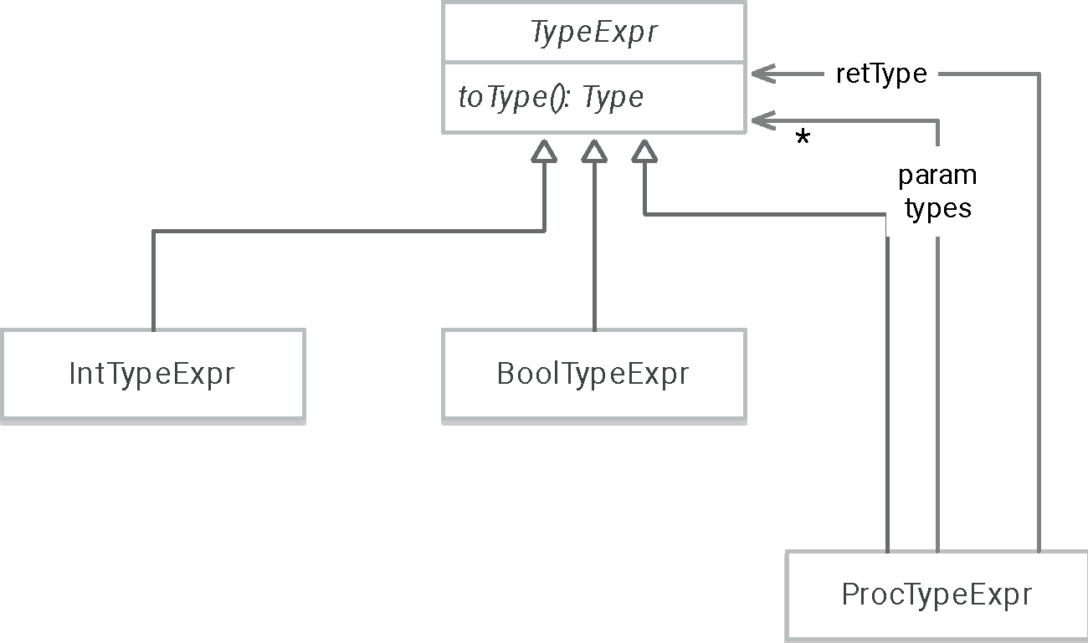
Representation of Type Notation Found in Source => in AST
toType() methods generate the Type objects stored in the TypeEnv bindings.
toString() methods return back the same
notation found in the source code.

Slide 24
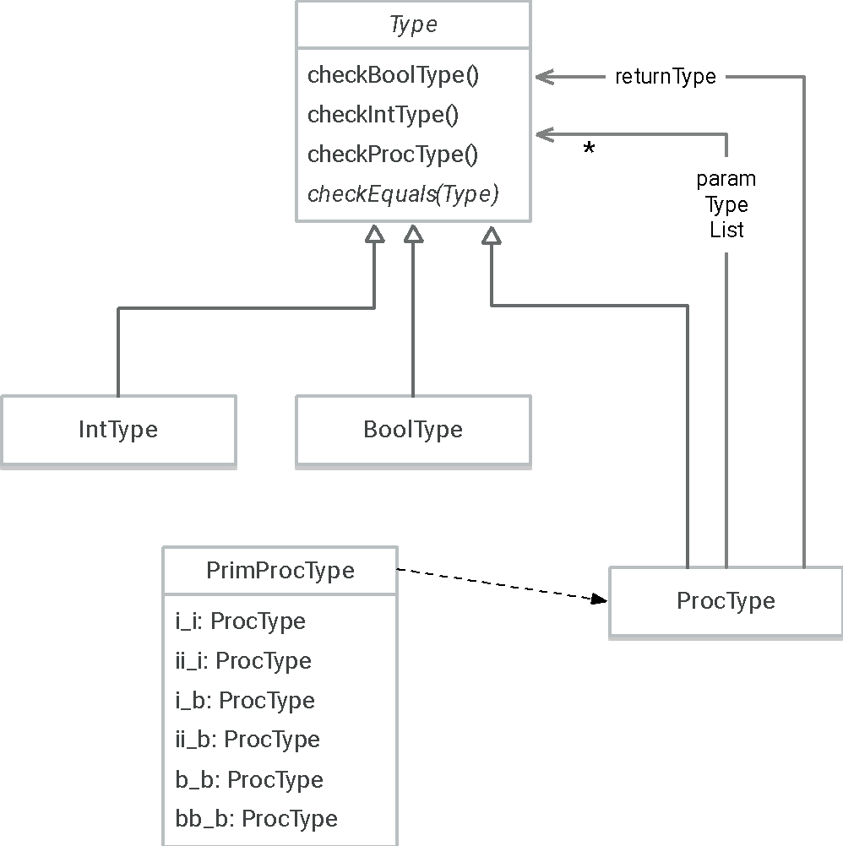
TYPE1 Internal Type Repre-sentation
toString() methods still return back the same notation found in the source code (handy for homework).

Slide 25
Evaluating, via Exp.evalType(TypeEnv),
Different Expressions' Types, Slide 1
Literal
  Instantly identifiable as int or bool
Variable
  Type is found in the type environment
Primitive application
  ProcType instances of primitives are hard-coded in PrimProcType-i.java.
  Ask the Prim instance for its definedType.
    Prim.definedType() returns the correct hard-coded instance.
  Evaluate operands' types, and match against hard-coded formals' types.

Slide 26
Evaluating, via Exp.evalType(TypeEnv),
Different Expressions' Types, Slide 2
Proc
  Extract type info from the ProcExpr itself.
  Environment need not be saved as a "type closure"; think about it.
  Evaluate the type of the body.
    Add a new type environment with the formals bound to their types.
    The type correctness of the body will be checked in the process.
  Make sure the type of the evaluated body expression matches the declared type.
Proc application
  Evaluate the type of the expression that is supposed to be the proc.
  Make sure the operands' types (and number) match the formals' types.
  Type is the return type of the proc being applied.
Notes:
You don't need to save a type closure because the only time you'll actually check type compatibility is right now.

Slide 27
Evaluating, via Exp.evalType(TypeEnv),
Different Expressions' Types, Slide 3
If
  Make sure if expression type is bool.
  Make sure then and else expressions' types match.
  Type is the type of the then and else expressions.
Let : like proc
  Check for duplicated variable names in let list. (not really a type issue)
  Bind let variables' types to their expressions' evaluated types, in a new TypeEnv.
  Type is the type of the in expression.

Slide 28
Evaluating, via Exp.evalType(TypeEnv),
Different Expressions' Types, Slide 4
Letrec : what is different from let
  Gather up all the bindings of variables to their RHS types
    Trick: Trust the defined types of any procs; don't look at bodies.🙈
  Make a new type environment from the bindings.
  Go back and reevaluate the expressions' types carefully using the types from the environment.
  (Trick not done this time.)

Slide 29
Evaluating, via Exp.evalType(TypeEnv),
Different Expressions' Types, Slide 5
Set
  Type of expression is the type of the RHS.
  Extra work: Make sure that type matches the "declared" type of the LHS variable.
Sequence
  Type of expression is the type of the final expression.
  Extra work: All expressions must be checked for internal type consistency.

Slide 30
When you look at the code
In the end, for most of the checks, it comes down to this question.
Is this type the same as that type?
The code to do this often ends up in a procedure that does not return a true/false answer.
The most basic code either
  returns silently ("true") 👍, or
  throws an exception ("false") 🤯.

Slide 31
Code File Organization, Slide 1
TYPE1
├── TYPE1.plcc
├── Program-i.java
├── Declare-i.java
├── Define-i.java
├── Eval-i.java
├── Formals-i.java
├── LetDecls-i.java
├── LetrecDecls-i.java
├── Operands-i.java
Token definitions
Grammar
include files
Main grammar element and its choices
NEW: to be discussed
(random grammatical elements needed by others)

Slide 32
Code File Organization, Slide 2
Standard support tor the value bindings
(and references)
TYPE1
├── EnvSource
│ ├── Binding*-i.java
│ ├── *Val-i.java
│ ├── Env*-i.java
│ └── Ref-i.java
├── ExpSource
│ └── *Exp-i.java
├── PrimSource
│ └── *Prim-i.java
Expression objects from the parse tree. Now includes evaluating their types and values.
All information pertinent to primitive (built-in) procedures, including their types.
(But see Slide 4.)

Slide 33
Code File Organization, Slide 3
TYPE1
├── TypeEnvSource
│ ├── TypeBinding*-i.java
│ └── TypeEnv*-i.java
├── TypeExprSource
│ ├── BoolTypeExpr-i.java
│ ├── IntTypeExpr-i.java
│ ├── ProcTypeExpr-i.java
│ └── TypeExpr-i.java
The special type bindings used only during
type-checking
The AST nodes for type descriptions. They get converted to internal types...

Slide 34
Code File Organization, Slide 4
TYPE1
├── TypeSource
│ ├── Type-i.java
│ ├── BoolType-i.java
│ ├── IntType-i.java
│ ├── PrimProcType-i.java
│ └── ProcType-i.java
TYPE1's internal representation of types. Includes type matching (comparison) and errors.
Stored in the type environment bindings.
Hard-coded descriptions of built-in primitive procedures

Slide 35
Code Examples 1 define p = proc( x: int, y: bool ): int if y then add1(x) else x
$ rep eg1.type1
p set to λ(x,y){return y ? add1(x) : x}
--> .p( 3, false ) .p( 4, false )
3
4
--> .p( 3 )
Param/operand list size mismatch
--> .p( 3, 1 )
Type mismatch, IntType and BoolType
--> .p( proc(): int 1, true )
Type mismatch, [ => IntType ] and IntType
From Type.checkEqualTypes(),
called by
ProcType.checkProcType()

Slide 36
Code Examples 2
$ rep
--> if 5 then 6 else 7
Type mismatch, BoolType and IntType
--> if true then 6 else false
Type mismatch, BoolType and IntType
--> let n = 10 in set n = true
Type mismatch, BoolType and IntType
--> proc( x: int ): int ==?(x,0)
Type mismatch, BoolType and IntType
--> proc( x: int ): int proc(): int add1(x)
Type mismatch, [ => IntType ] and IntType

Slide 37
Note that this does not work.
$ cat oe.type1
define odd? = proc(t:int):bool if zero?(t) then false
else .even?(sub1(t))
define even? = proc(t:int):bool if zero?(t) then true
else .odd?(sub1(t))
$ rep oe.type1
No type binding for even?
--> odd?
No type binding for odd?
The definition of odd? cannot be type-checked because even? is not in the TypeEnv at this point in time.

Slide 38
Fix: New Program type: declare
$ cat oe.type1
declare odd? : [int=>bool] % not really necessary
declare even? : [int=>bool]
define odd? = proc(t:int):bool if zero?(t) then false
else .even?(sub1(t))
define even? = proc(t:int):bool if zero?(t) then true
else .odd?(sub1(t))

Slide 39
Fix: New Program type: Declare
$ rep oe.type1
odd?: [ IntType => BoolType ]
even?: [ IntType => BoolType ]
odd? set to λ(t){return zero?(t) ? false : CALL [even?](sub1(t))}
even? set to λ(t){return zero?(t) ? true : CALL [odd?](sub1(t))}
--> .odd?( 9 )
true
--> .even?( 9 )
false
declare odd? : [int=>bool]
declare even? : [int=>bool]
define odd? = proc(t:int):bool
if zero?(t) then false else .even?(sub1(t))
define even? = proc(t:int):bool
if zero?(t) then true else .odd?(sub1(t))

Slide 40
Simple recursive functions need this, too.
declare fact : [ int => int ]
define fact =
proc( x: int ): int
if zero?( x )
then 1
else *( x, .fact( sub1( x ) ) )
(Could have been done like letrec, though.)

Slide 41
You do not need this if you use letrec.
letrec
odd? = proc(t:int):bool if zero?(t) then false else .even?(sub1(t))
even? = proc(t:int):bool if zero?(t) then true else .odd?(sub1(t))
fact =
proc( x: int ): int
if zero?( x )
then 1
else *( x, .fact( sub1( x ) ) )
in
.odd?( .fact( 5 ) )
Letrec : what is different from let
  Gather up all the bindings of variables to their RHS types
    Trick: Trust the defined types of any procs; don't look at bodies.
  Make a new environment from the bindings.
  Go back and reevaluate the types carefully using the types from the environment.
  (Trick not done this time.)

Slide 42
Not useful, but you can declare any type.
--> declare x: int
x: IntType
--> declare subx: [ int => int ]
subx: [ IntType => IntType ]
--> define subx = proc( i: int ): int -( i, x )
subx set to λ(i){return -(i,x)}
--> define x = false
Type mismatch, BoolType and IntType

Slide 43
Type Checking: SUMMARY
Static type checking: inference vs declaration
Major categories of type problems
  non-matching types in set, proc args/formals, proc return type/body
  proc args/formals count mismatch
  if statement issues
  apply non-proc

Slide 44
Type Checking: SUMMARY
TYPE0 language: adds syntax of type declarations to REF
  proc formal types, return type
  syntax for describing type OF a proc
TYPE1 language: Really check types.
  Done in separate, earlier, semantic analysis phase.
Booleans are now a full and separate type.

Slide 45
Type Checking: SUMMARY
TYPE1: Type Checking: The General Design
  "Run" the program where variables are bound to their types, not any values.
  If the above step doesn't fail, go ahead and do normal evaluation.
For both type checking and real execution, each expression gets evaluated against bindings present in the environment it's given.

Slide 46
Type Checking: SUMMARY
Three new sections of semantic code
  Support for the syntactical elements of types
  Support for internal representations of types, and how to get them from the above
  Support for type bindings in type environments where internal type representations are stored
Pre-declaration of a proc's type so that type-checking of global recursive and mutually recursive functions works

